Slide 1
Occupational Health and Safety
EC/Env-309
(3 = 2+1)
BS SEMESTER 6
SESSION 2017-21
Course Tutor: Ms. Hina Chaudhry

Slide 2


Slide 3
Aim:
To study about different methods used for controlling occupational hazards.
Outcomes:
The students will be able to:
Understand different methods used for controlling occupational hazards
Differentiate between these methods
Apply these methods in different workplaces

Slide 4
Topic of course outline:
Methods of Control of Occupational Hazards PART 2:
Elimination
Substitution
Engineering controls
Administrative Controls
Personal Protective Equipment PPE

Slide 5


Slide 6


Slide 7


Slide 8


Slide 9


Slide 10
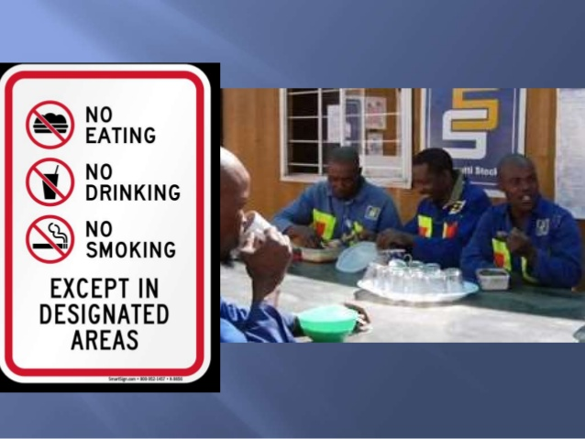

Slide 11
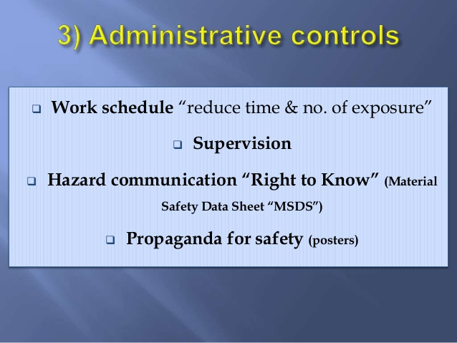

Slide 12


Slide 13
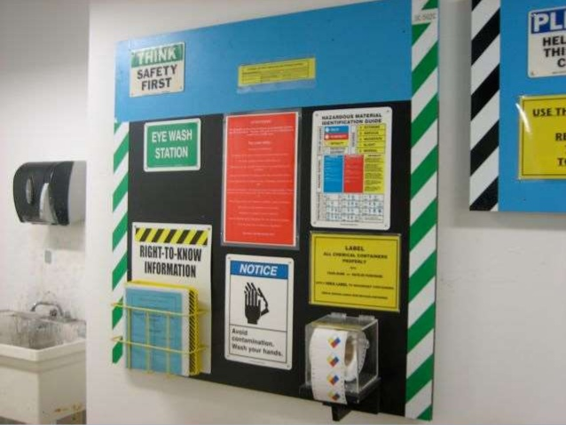

Slide 14


Slide 15


Slide 16
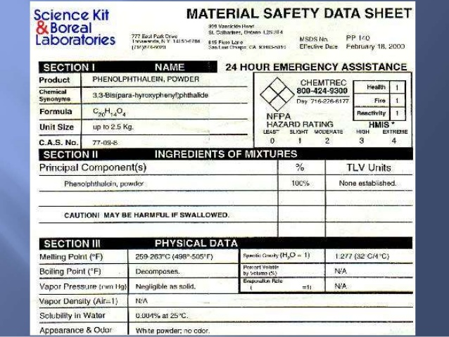

Slide 17


Slide 18


Slide 19


Slide 20
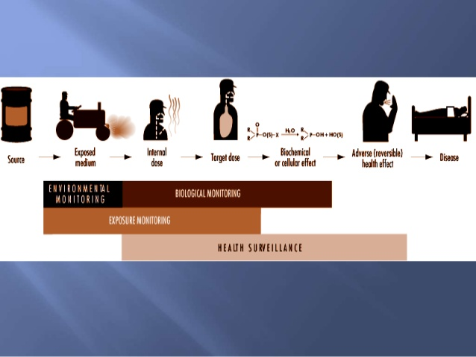

Slide 21


Slide 22
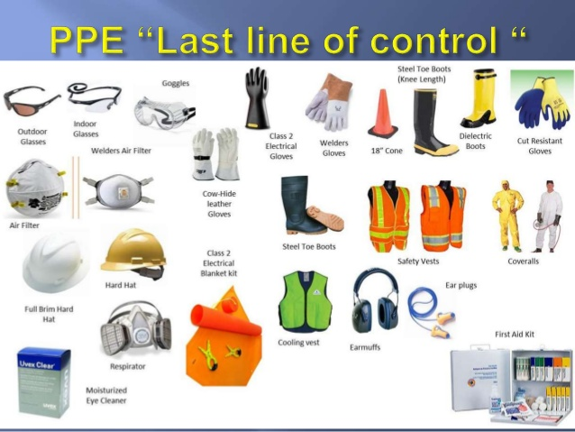

Slide 23
READING MATERIAL:
Occupational Health controls.
DISCUSSION/ QUERIES

